Slide 1
Python Example Applications

Slide 2

James Webb Space Telescope (JWST)
Python is the most common programming language that folks in the astronomy field utilize, because it’s “the language of data analysis, data manipulation, and data inference,” Nitya Mandyam, Astrophysics PhD, Senior Curriculum Developer at Codecademy
As JWST orbits 1 million miles away, software engineers back on earth use Python to receive, organize, and file all the data that comes from the telescope.
One can download the JWST data & analyze it with Python
Source - https://www.codecademy.com/resources/blog/nasa-james-webb-space-telescope-python-data/

Slide 3
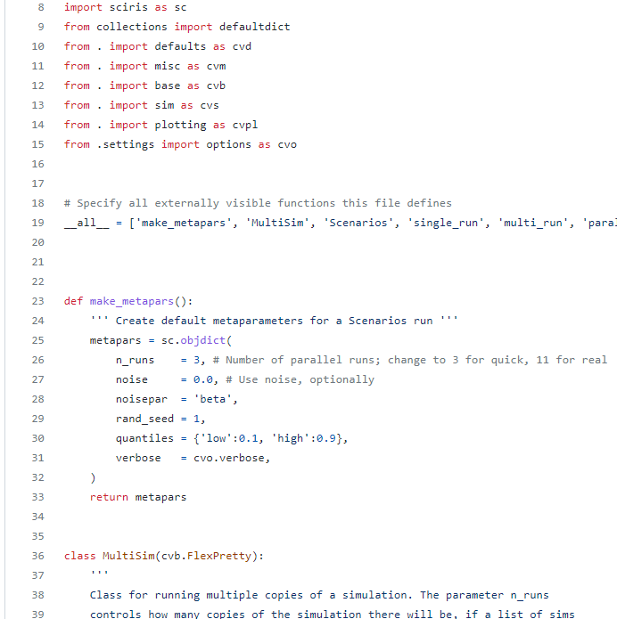
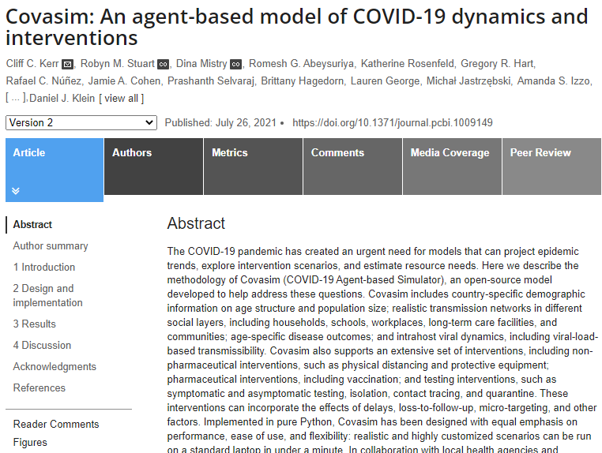
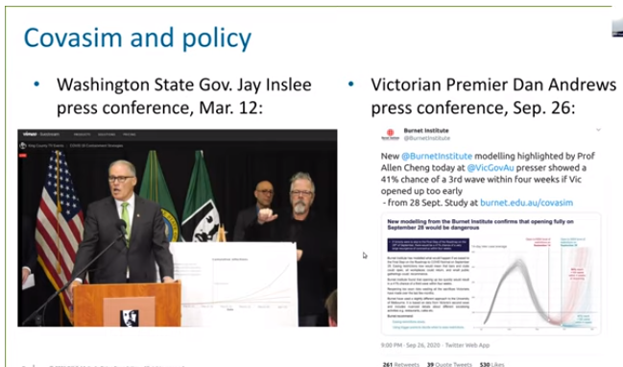
COVID-19

Slide 4
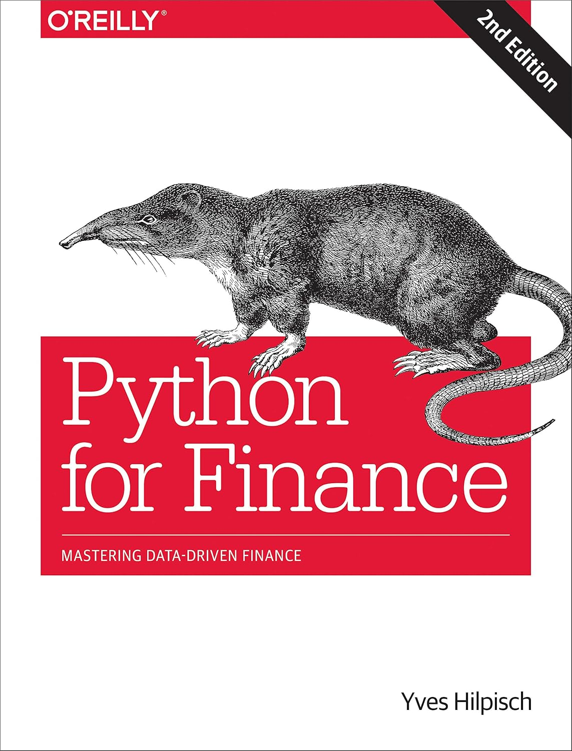

Python for Finance
yfinance library – uses Yahoo finance

Slide 5


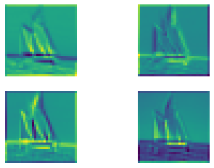
Object Recognition and Tracking
Coast Guard Academy cadet directed studies and capstone projects on Vessel Detection

Slide 6
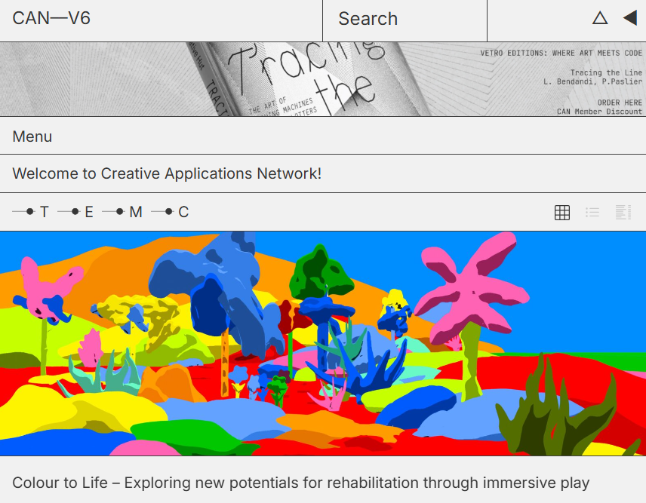
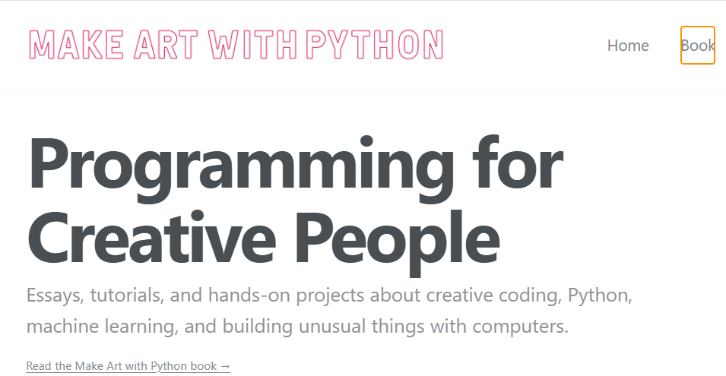
Python for Creative Applications
https://www.makeartwithpython.com/ https://www.creativeapplications.net/

Slide 7
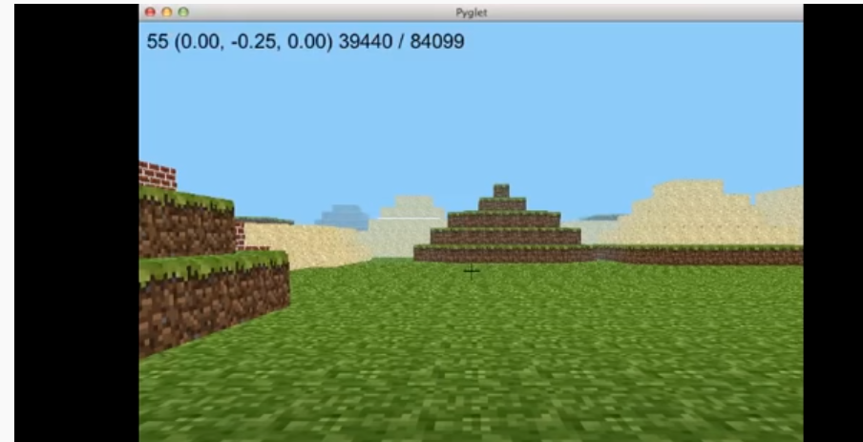
Fun
Minecraft in Python
https://www.youtube.com/watch?v=kC3lwK631X8

Slide 8
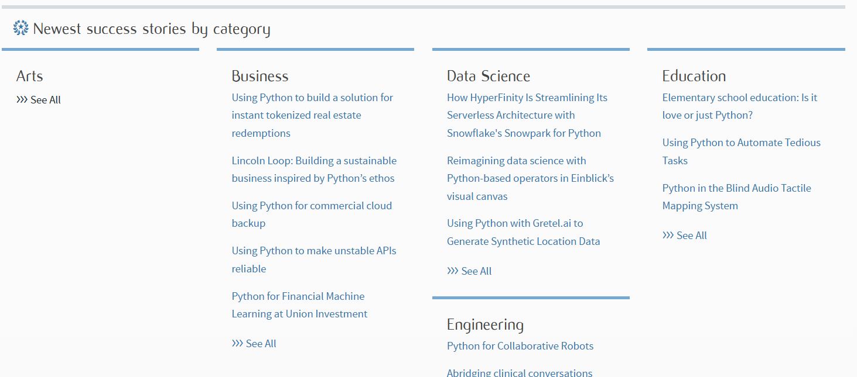
https://www.python.org/success-stories/

